Slide 1
Guide to Programming with Python
Chapter Eleven
Graphics: The Pizza Panic Game

Slide 2
Objectives
Create a graphics window
Create and manipulate sprites
Display text in a graphics window
Test for collisions between sprites
Handle mouse input
Control a computer opponent
Guide to Programming with Python

Slide 3
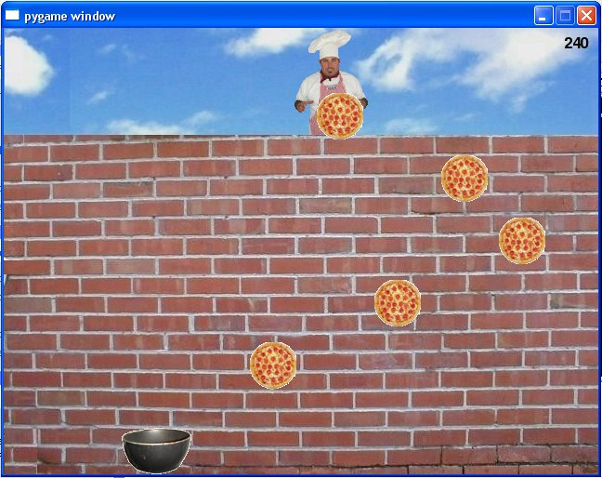
The Pizza Panic Game
Figure 11.1: Sample run of the Pizza Panic game
The player must catch the falling pizzas.
Guide to Programming with Python

Slide 4
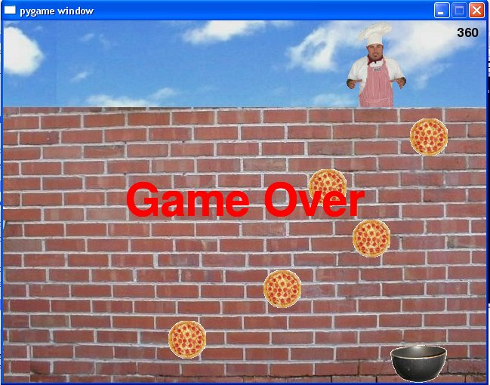

The Pizza Panic Game (continued)
Figure 11.2: Sample run of the Pizza Panic game
Once the player misses a pizza, the game is over.
pizza_panic.py
Guide to Programming with Python

Slide 5
The pygame and livewires Packages
Package: Set of modules
pygame module
  Provides access to wide range of multimedia classes
  Made especially for writing games
livewires module
  Built on top of pygame, easier to use
  Used for all graphics games in textbook
Guide to Programming with Python

Slide 6
Creating a Graphics Window
Graphics window
  Must create as first step in graphics program
  All images and text displayed on it
Guide to Programming with Python

Slide 7
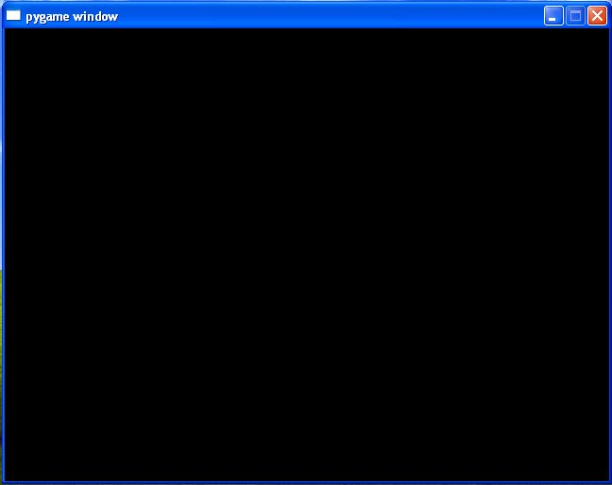
The New Graphics Window Program
Figure 11.3: Sample run of the New Graphics Window program
A first graphics window. Not much, but it’s a start.
Guide to Programming with Python

Slide 8
The New Graphics Window Program (continued)
from livewires import games
games.init(screen_width = 640, screen_height = 480,
fps = 50)
games.screen.mainloop()
(screen_width is really window width
screen_height is really window height)
Guide to Programming with Python

Slide 9
Importing the games Module
from livewires import games
from statement lets you import specific module from a package
livewires package made up of several important modules, including games
games contains classes and functions for game programming
new_graphics_window.py
Guide to Programming with Python

Slide 10
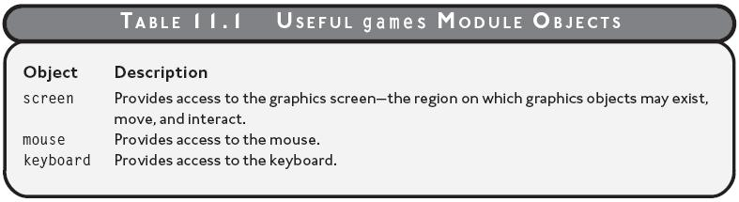
games Module Objects
Table 11.1: Useful games module objects
Guide to Programming with Python

Slide 11
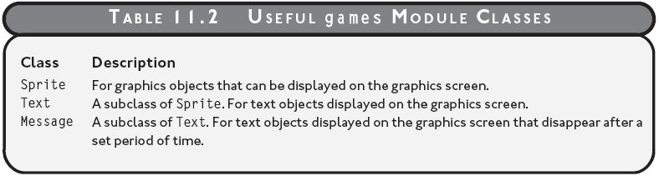
games Module Classes
Table 11.2: Useful games module classes
Guide to Programming with Python

Slide 12
Initializing a Graphics Window
games.init(screen_width = 640, screen_height = 480,
fps = 50)
games init() creates a new graphics window
  screen_width for screen (window) width
  screen_height for screen (window) height
  Screen dimensions measured in pixels
  Pixel: single point on graphics screen
  fps (frames per second) for number of times screen updated each second
Here, window width 640, height 480, updated 50 times per second
Guide to Programming with Python

Slide 13
Starting the Main Loop
games.screen.mainloop()
screen represents the graphics screen
screen.mainloop()
  Updates graphics screen fps times per second
  Keeps the graphics window open
Guide to Programming with Python

Slide 14
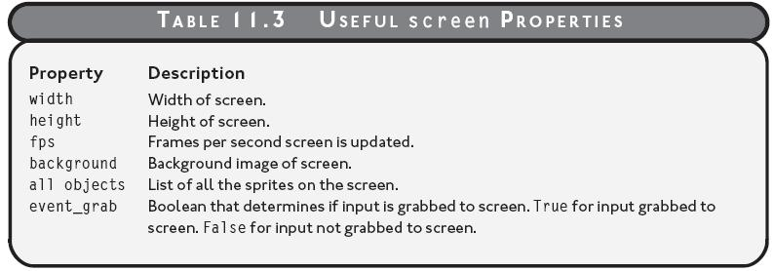
Useful screen Properties
Can get and set these properties with game.screen.<property>
Table 11.3: Useful screen properties
Guide to Programming with Python

Slide 15
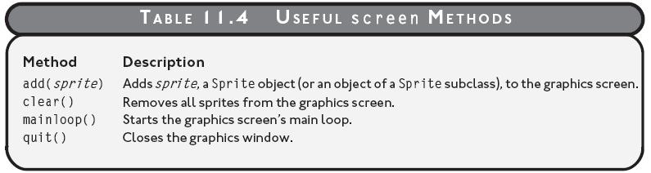
Useful screen Methods
Table 11.4: Useful screen methods
Guide to Programming with Python

Slide 16
Setting a Background Image
Background image
  Generally want one
  Example: Brick wall image in Pizza Panic game
Guide to Programming with Python

Slide 17
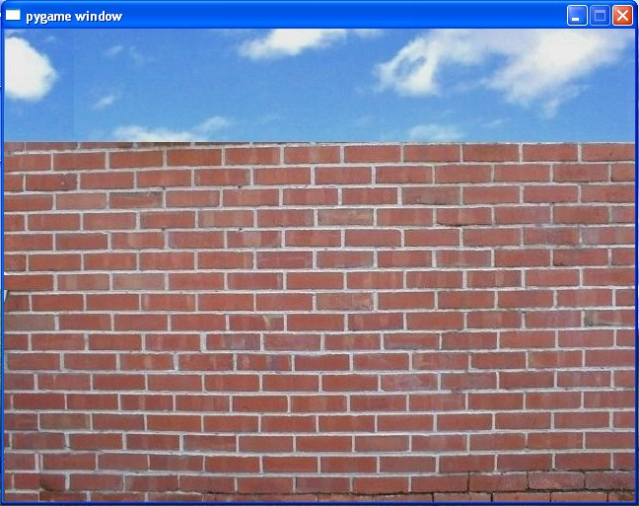
The Background Image Program
Figure 11.4: Sample run of the Background Image program;
background property of screen used to set background.
Guide to Programming with Python

Slide 18
The Background Image Program (continued)
from livewires import games
games.init(screen_width = 640, screen_height = 480,
fps = 50)
wall_image = games.load_image("wall.jpg",
transparent = False)
games.screen.background = wall_image
games.screen.mainloop()
Guide to Programming with Python

Slide 19
Loading an Image
wall_image = games.load_image("wall.jpg",
transparent = False)
load_image() function
  Loads and returns image object
  Works with JPG, BMP, GIF, PNG, PCX, and TGA files
  Takes two arguments
    String for file name of the image
    True or False for transparent (use False for background image)
Here, wall_image set to image stored in wall.jpg
Guide to Programming with Python

Slide 20
Setting the Background
games.screen.background = wall_image
background property
  Represents background of graphics screen
  Can be assigned an image object
Here, screen background is set to wall_image
background_image.py
Guide to Programming with Python

Slide 21
Understanding the Graphics Coordinate System
Graphics screen made up of rows and columns of pixels
Specify point on screen with coordinates: x and y
  x represents column
  y represents row
  Upper-leftmost pixel is (0,0)
Can place graphics objects anywhere on screen using this coordinate system
Guide to Programming with Python

Slide 22
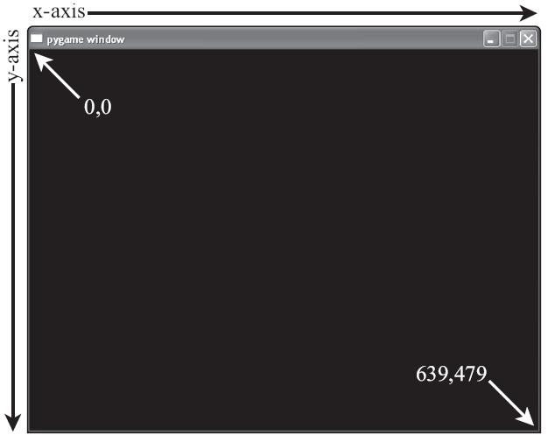
Understanding the Graphics Coordinate System (continued)
Figure 11.5: Graphics coordinate system
Specify points on graphics screen with x- and y-coordinate pairs.
Guide to Programming with Python

Slide 23
Displaying a Sprite
Sprite: A graphics object with an image
Example: The chef, pizzas, and pan in the Pizza Panic game
Guide to Programming with Python

Slide 24
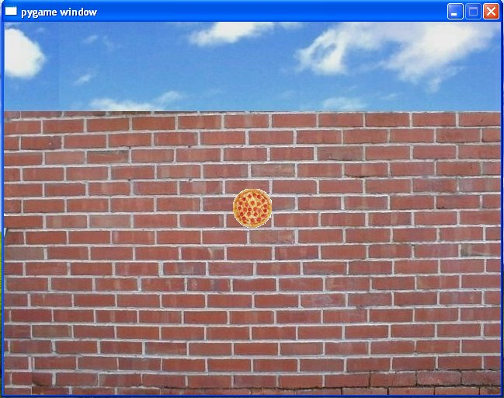
The Pizza Sprite Program
Figure 11.6: Sample run of the Pizza Sprite program
The pizza image is not part of the background, but a sprite.
Guide to Programming with Python

Slide 25
The Pizza Sprite Program (continued)
from livewires import games
games.init(screen_width = 640, screen_height = 480,
fps = 50)
wall_image = games.load_image("wall.jpg",
transparent = False)
games.screen.background = wall_image
pizza_image = games.load_image("pizza.bmp")
pizza = games.Sprite(image = pizza_image,
x = 320, y = 240)
games.screen.add(pizza)
games.screen.mainloop()
Guide to Programming with Python

Slide 26
Loading an Image for a Sprite
pizza_image = games.load_image("pizza.bmp")
In load_image(), default value for transparent is True
transparent set to True allows background to show through transparent parts of image
Color of pixel at the upper-left corner of image is its transparent color
Guide to Programming with Python

Slide 27
Loading an Image for a Sprite (continued)
All parts of image that are its transparent color allow background to show through
Here, pizza_image set to image stored in pizza.bmp with transparency
Guide to Programming with Python

Slide 28
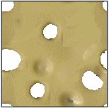
Loading an Image for a Sprite (continued)
Figure 11.7: Swiss cheese image
On solid background to take advantage of transparency.
Guide to Programming with Python

Slide 29
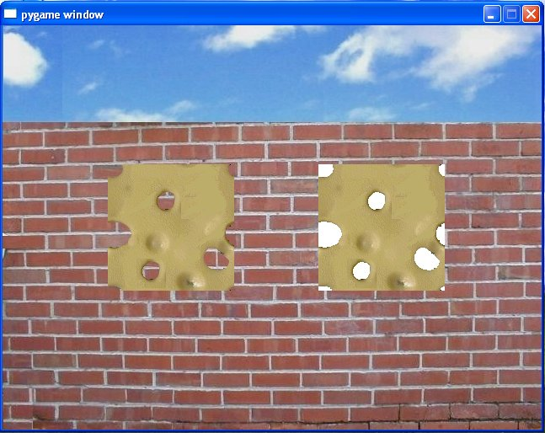
Loading an Image for a Sprite (continued)
Figure 11.8: Swiss cheese image loaded two ways
On left, transparent True; on right, transparent False.
Guide to Programming with Python

Slide 30
Creating a Sprite
pizza = games.Sprite(image = pizza_image,
x = 320, y = 240)
Sprite is class for sprite
  image is for image
  x is for x-coordinate
  y is for y-coordinate
Here, pizza gets Sprite object with pizza image at (320,240) – center of screen
Guide to Programming with Python

Slide 31
Adding a Sprite to the Screen
games.screen.add(pizza)
Sprite must be added to screen to be displayed
screen.add() adds sprite to screen
Here, pizza is added to screen
Guide to Programming with Python

Slide 32
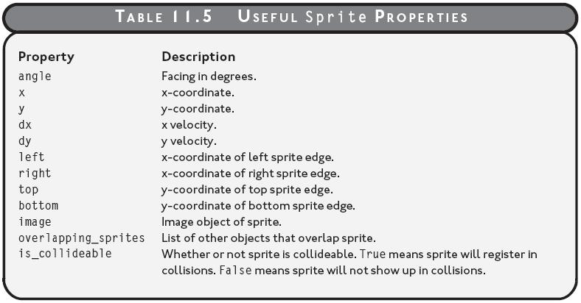
Useful Sprite Properties
Table 11.5: Useful Sprite properties
Guide to Programming with Python

Slide 33
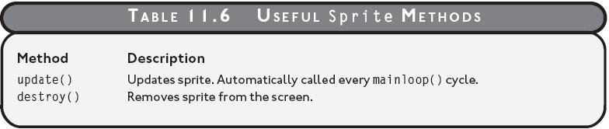
Useful Sprite Methods
Table 11.6: Useful Sprite methods
pizza_sprite.py
Guide to Programming with Python

Slide 34
Displaying Text
Can display text on screen
Example: The player’s score in the Pizza Panic game
Guide to Programming with Python

Slide 35
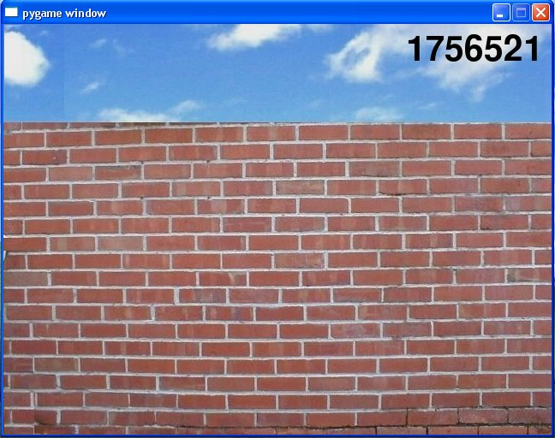
The Big Score Program
Figure 11.9: Sample run of the Big Score program
The score is displayed after a Text object is instantiated.
Guide to Programming with Python

Slide 36
Importing the color Module
from livewires import games, color
color
  Module in livewires package
  Defines set of constants for colors
  Constants can be used with Text objects
  Example: color.black
Guide to Programming with Python

Slide 37
Creating a Text Object
score = games.Text(value = 1756521, size = 60,
color = color.black, x = 550, y = 30)
Text is class for text on graphics screen
  value is for value to be displayed as text
  size is for height in pixels
  color is for color
Here, score gets Text object displayed as 1756521, 60 pixels high in black at (550,30)
Guide to Programming with Python

Slide 38
Adding a Text Object to the Screen
games.screen.add(score)
Text object must be added to screen to be displayed
Here, score is added to the screen
Guide to Programming with Python

Slide 39
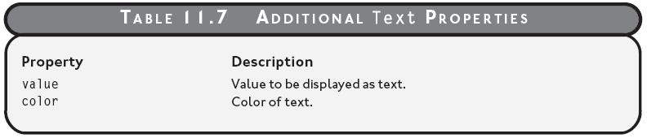
Useful Text Properties
Table 11.7: Additional Text properties
big_score.py
Guide to Programming with Python

Slide 40
Displaying a Message
Message is temporary text, disappears after set period of time
Example: “Game Over!” in the Pizza Panic game
Guide to Programming with Python

Slide 41
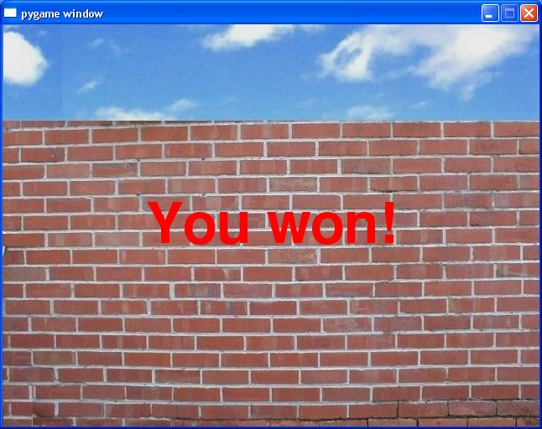
The You Won Program
Figure 11.10: Sample run of the You Won program
The message disappears after a few seconds.
Guide to Programming with Python

Slide 42
Importing the color Module
from livewires import games, color
color
  Constants can be used with Message objects
Guide to Programming with Python

Slide 43
Creating a Message Object
won_message = games.Message(
value = "You won!",
size = 100,
color = color.red,
x = games.screen.width/2,
y = games.screen.height/2,
lifetime = 250,
after_death = games.screen.quit)
Guide to Programming with Python

Slide 44
Creating a Message Object (continued)
Message is class for message on graphics screen
  lifetime is for number of mainloop() cycles message lives (fps * seconds)
  after_death is for function to be called just before object disappears (default value None)
Here, message “You Won!” appears in big, red letters at the center of screen for about five seconds, then program ends
Guide to Programming with Python

Slide 45
Using the Screen’s Width and Height
screen.width property represents width of graphics screen
screen.height property represents height of graphics screen
Sometimes clearer to use screen.width and screen.height rather than literal integers
(games.screen.width/2, games.screen.height/2) is middle of screen regardless of screen dimensions
Guide to Programming with Python

Slide 46
Adding a Message Object to the Screen
games.screen.add(won_message)
Message object must be added to screen to be displayed
Here, won_message is added to the screen
Guide to Programming with Python

Slide 47
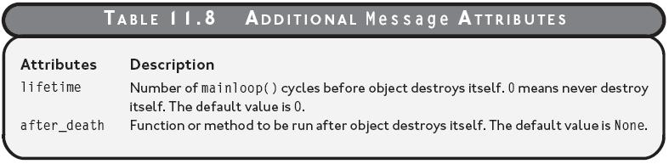
Adding a Message Object to the Screen (continued)
Table 11.8: Additional Message attributes
you_won.py
Guide to Programming with Python

Slide 48
Moving Sprites
Moving images essence of most games
Sprites have properties for movement
Guide to Programming with Python

Slide 49

The Moving Pizza Program
Figure 11.11: Sample run of the Moving Pizza Program
Pizza moves in direction of arrow.
Guide to Programming with Python

Slide 50
Setting a Sprite’s Velocity Values
the_pizza = games.Sprite(
image = pizza_image,
x = games.screen.width/2,
y = games.screen.height/2,
dx = 1,
dy = 1)
Guide to Programming with Python

Slide 51
Setting a Sprite’s Velocity Values (continued)
dx
  "delta" x (change in x)
  Value added to x each mainloop() cycle
  Default value is 0
dy
  "delta" y (change in y)
  Value added to y each mainloop() cycle
  Default value is 0
moving_pizza.py
Guide to Programming with Python

Slide 52
Dealing with Screen Boundaries
Create mechanism to deal with the graphics window’s boundaries for moving sprites
Some options for sprite reaching screen edge
  Explode
  Bounce
  Wrap around
Guide to Programming with Python

Slide 53

The Bouncing Pizza Program
Figure 11.12: Sample run of the Bouncing Pizza program
Pizza bounces around, following path of arrow.
Guide to Programming with Python

Slide 54
Setting Up the Program
from livewires import games
games.init(screen_width = 640, screen_height = 480,
fps = 50)
Guide to Programming with Python

Slide 55
Deriving a New Class from Sprite
class Pizza(games.Sprite):
""" A bouncing pizza. """
def update(self):
""" Reverse a velocity component if edge of screen
reached. """
if self.right > games.screen.width or self.left < 0:
self.dx = -self.dx
if self.bottom > games.screen.height or self.top < 0:
self.dy = -self.dy
Guide to Programming with Python

Slide 56
Overriding the update() Method
Sprite.update()
  Called for each Sprite object every mainloop() cycle
  Provides opportunity for object to do something
Pizza.update()
  Overrides Sprite.update(), which does nothing
  Checks if object is about to go beyond screen limits; if so, reverses the responsible velocity
  Causes pizza to "bounce" off screen edges.
Guide to Programming with Python

Slide 57
Wrapping Up the Program
def main():
wall_image = games.load_image("wall.jpg",
transparent = False)
games.screen.background = wall_image
pizza_image = games.load_image("pizza.bmp")
the_pizza = Pizza(image = pizza_image,
x = games.screen.width/2,
y = games.screen.height/2,
dx = 1,
dy = 1)
games.screen.add(the_pizza)
games.screen.mainloop()
# kick it off!
main()
bouncing_pizza.py
Guide to Programming with Python

Slide 58
Handling Mouse Input
Interactivity is key ingredient in games
Can check mouse position for player input
Guide to Programming with Python

Slide 59
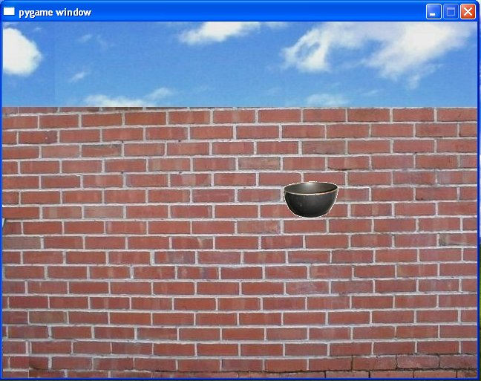
The Moving Pan Program
Figure 11.13: Sample run of the Moving Pan program
Pan sprite follows mouse around graphics screen.
Guide to Programming with Python

Slide 60
Setting Up the Program
from livewires import games
games.init(screen_width = 640, screen_height = 480,
fps = 50)
Guide to Programming with Python

Slide 61
Reading Mouse X- and Y-Coordinates
class Pan(games.Sprite):
"""" A pan controlled by the mouse. """
def update(self):
""" Move to mouse coordinates. """
self.x = games.mouse.x
self.y = games.mouse.y
mouse
  games object
  Represents mouse pointer
  x property for its x-coordinate
  y property for its y-coordinate
Guide to Programming with Python

Slide 62
Reading Mouse X- and Y-Coordinates (continued)
def main():
wall_image = games.load_image("wall.jpg",
transparent = False)
games.screen.background = wall_image
pan_image = games.load_image("pan.bmp")
the_pan = Pan(image = pan_image,
x = games.mouse.x,
y = games.mouse.y)
games.screen.add(the_pan)
Pan object starts off at mouse coordinates
Guide to Programming with Python

Slide 63
Setting Mouse Pointer Visibility
games.mouse.is_visible = False
is_visible
  Property determines if mouse pointer displayed
  Set to True, mouse pointer displayed
  Set to False, mouse pointer not displayed
Guide to Programming with Python

Slide 64
Grabbing Input to the Graphics Window
games.screen.event_grab = True
event_grab
  Property determines if input focused to screen
  Set to True, input focused to screen (mouse pointer won't leave screen)
  Set to False, input not focused to screen (mouse pointer can leave screen)
Guide to Programming with Python

Slide 65
Wrapping Up the Program
games.screen.mainloop()
# kick it off!
main()
Guide to Programming with Python

Slide 66
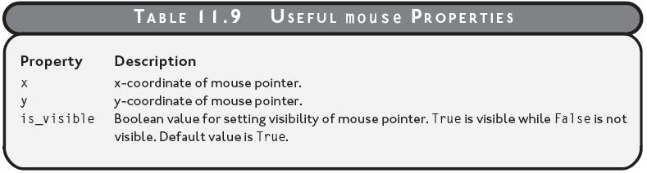
Wrapping Up the Program (continued)
Table 11.9: Useful Mouse properties
moving_pan.py
Guide to Programming with Python

Slide 67
Detecting Collisions
Collisions play role in almost all games
Can detect collisions between sprites
Guide to Programming with Python

Slide 68
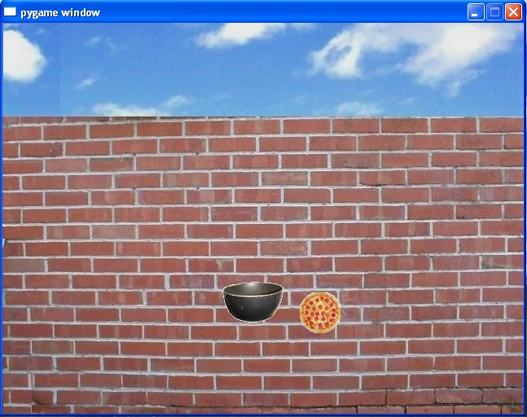
The Slippery Pizza Program
Figure 11.14: Sample run of the Slippery Pizza program
The player almost reaches the pizza.
Guide to Programming with Python

Slide 69
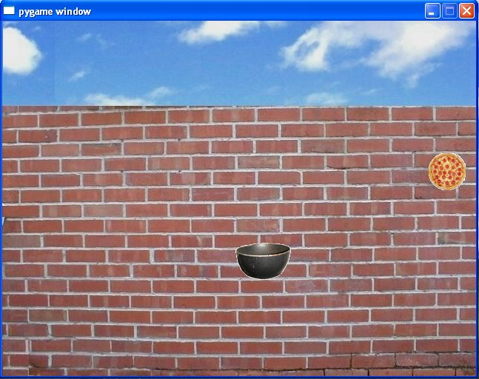
The Slippery Pizza Program (continued)
Figure 11.15: Sample run of the Slippery Pizza program
The slippery pizza gets away again.
Guide to Programming with Python

Slide 70
Setting Up the Program
from livewires import games
import random
games.init(screen_width = 640, screen_height = 480,
fps = 50)
Guide to Programming with Python

Slide 71
Detecting Collisions
class Pan(games.Sprite):
"""" A pan controlled by the mouse. """
def update(self):
""" Move to mouse position. """
self.x = games.mouse.x
self.y = games.mouse.y
self.check_collide()
def check_collide(self):
""" Check for collision with pizza. """
for pizza in self.overlapping_sprites:
pizza.handle_collide()
Guide to Programming with Python

Slide 72
Detecting Collisions (continued)
overlapping_sprites
  Sprite property
  List of all of the sprites that overlap given sprite
update() invokes check_collide()
check_collide() loops through Pan object’s overlapping_sprites property
Each object that overlaps Pan object has its handle_collide() method called
Guide to Programming with Python

Slide 73
Handling Collisions
class Pizza(games.Sprite):
"""" A slippery pizza. """
def handle_collide(self):
""" Move to a random screen location. """
self.x = random.randrange(games.screen.width)
self.y = random.randrange(games.screen.height)
handle_collide() moves Pizza object to random location
So, every time the pan hits a pizza, the pizza jumps to a random location
Guide to Programming with Python

Slide 74
Wrapping Up the Program
def main():
wall_image = games.load_image("wall.jpg",
transparent = False)
games.screen.background = wall_image
pizza_image = games.load_image("pizza.bmp")
pizza_x = random.randrange(games.screen.width)
pizza_y = random.randrange(games.screen.height)
the_pizza = Pizza(image = pizza_image,
x = pizza_x, y = pizza_y)
games.screen.add(the_pizza)
Guide to Programming with Python

Slide 75
Wrapping Up the Program (continued)
pan_image = games.load_image("pan.bmp")
the_pan = Pan(image = pan_image,
x = games.mouse.x,
y = games.mouse.y)
games.screen.add(the_pan)
games.mouse.is_visible = False
games.screen.event_grab = True
games.screen.mainloop()
# kick it off!
main()
slippery_pizza.py
Guide to Programming with Python

Slide 76
The Pizza Panic Game
Figure 11.1: Sample run of the Pizza Panic game
The player must catch the falling pizzas.
pizza_panic.py
Guide to Programming with Python

Slide 77
Summary
games is a module that contains objects, functions, and classes for writing 2D games
The games.init() function creates a new graphics screen
The games.load_image() function loads an image stored in a graphics file and returns an image object
color is a module that defines a set of constants for colors
screen is a games module object that provides access to the graphics screen
Guide to Programming with Python

Slide 78
Summary (continued)
screen has properties for width, height, background, and update rate, among others
The screen object has methods to add an object, remove all objects, begin its main loop, and quit, among others
mouse is a games module object that provides access to the mouse
mouse has properties for the x-coordinate and the y-coordinate of the mouse pointer as well as a property for mouse pointer visibility
Sprite is a class in the games module for graphics objects that can be displayed on the graphics screen
Guide to Programming with Python

Slide 79
Summary (continued)
A Sprite object has properties for its image, location, speed, orientation, and overlapping objects, among others
A Sprite object has methods for updating itself and destroying itself, among others
Text is a subclass of Sprite for text displayed on the graphics screen
Message is a subclass of Text for text displayed on the graphics screen that disappears after a set period of time
Guide to Programming with Python

